Slide 1
INFO 5100
Application Engineering & Development
Hospital Ecosystem
Authors
Saketh Sai Mallepudi Sashank Machiraju Suhasini Polampelly

Slide 2

Project Overview
The Hospital Ecosystem is a Java Swing application for managing hospital, ambulance service, diagnostics, and pharmacy.
It offers a user-friendly interface for managing patient data, appointments, and medical records across all enterprises.
The ambulance service component provides real-time tracking and monitoring of ambulance availability, dispatch, and transportation of patients to and from the hospital.
The diagnostics component provides laboratory services and medical testing facilities, and the pharmacy component provides a comprehensive inventory management system.
The Hospital Ecosystem includes robust security features to protect patient data from unauthorized access.
Problem statement
The Hospital Ecosystem is solving the problem of disjointed healthcare systems by providing a comprehensive solution that integrates hospital management, ambulance services, diagnostics, and pharmacy operations into a single platform. It streamlines healthcare operations and enhances patient outcomes by providing real-time tracking and monitoring, inventory management, and secure access to patient data across all enterprises when deemed necessary. This helps to improve the overall healthcare experience for both patients and healthcare providers.

Slide 3
Project Structure
Enterprises
Ambulance
Hospital
Diagnostics
Pharmacy
Organizations
Ambulance drivers
Ambulances
Diagnostic machine vendors
Medical Companies
Medicine Stores
Pharmacists
Diagnosticians
Roles
Doctor
Receptionist
Main System Admin
System Admins of 4 enterprises
Pharmacist
Patient
Diagnostician
Ambulance POC
Ambulance drivers

Slide 4




Implementation

Slide 5
Significance and role of enterprises
Hospital enterprise
The hospital is a crucial component of the Hospital Ecosystem as it serves as the central hub for patient care and medical treatment. The hospital component of the ecosystem provides features such as patient management, bed allocation, appointment scheduling, and inventory management, which are essential for managing hospital operations efficiently. It also facilitates communication and coordination with other enterprises in the ecosystem, such as the ambulance service, diagnostics, and pharmacy, to ensure timely and efficient medical care for patients. Overall, the hospital plays a vital role in the Hospital Ecosystem as it serves as the primary source of medical treatment and care for patients.
Ambulance enterprise
The ambulance enterprise is a critical component of the Hospital Ecosystem as it provides emergency medical services and ensures timely transportation of patients to and from the hospital. The ambulance service component of the ecosystem offers monitoring of ambulance availability, dispatch, and transportation, which helps to improve response times and reduce patient waiting times. The ambulance enterprise also works closely with the hospital to coordinate patient care, ensuring that patients receive the appropriate medical attention and treatment as quickly as possible. Overall, the ambulance enterprise plays a vital role in the Hospital Ecosystem by providing emergency medical services and ensuring seamless transportation of patients to and from the hospital.

Slide 6
Significance and role of enterprises
Diagnostics enterprise
The diagnostic enterprise is a critical component of the Hospital Ecosystem as it provides laboratory services. The diagnostics component of the ecosystem allows healthcare providers to quickly and accurately diagnose medical conditions, which is essential for providing appropriate treatment and care to patients. This helps to improve the quality of medical care and patient outcomes. The diagnostic enterprise also works closely with the hospital enterprise in the ecosystem to ensure that patient care is coordinated and efficient. Overall, the diagnostic enterprise plays a crucial role in the Hospital Ecosystem by providing essential laboratory services and ensuring accurate diagnosis and treatment of medical conditions.
Pharmacy enterprise
The pharmacy enterprise is a critical component of the Hospital Ecosystem as it provides a comprehensive inventory management system for medical supplies and medicines. It allows healthcare providers to manage medication orders, stock management, and sales effectively, ensuring that patients have access to the necessary medication and supplies they need to manage their medical conditions. The pharmacy enterprise works closely with the hospital and other enterprises to coordinate patient care and ensure that medication orders are fulfilled promptly. This is crucial for improving patient outcomes and promoting medication safety and adherence. Overall, the pharmacy enterprise plays a vital role in the Hospital Ecosystem by providing essential inventory management and medication services.

Slide 7

Use cases of the project
USE CASES OF THE HOSPITAL ECOSYSTEM PROJECT IN REAL-LIFE
Patient management: healthcare providers can manage patient data, appointments, and medical records across all enterprises in the ecosystem.
Bed allocation: the hospital component of the ecosystem includes features for managing bed allocation for patients.
Ambulance service: real-time tracking and monitoring of ambulance availability, dispatch, and transportation of patients to and from the hospital.
Laboratory services and medical testing: the diagnostics component provides laboratory services, test results management, report generation, and record maintenance.
Medication management: the pharmacy component provides a comprehensive inventory management system for medical supplies and medicines, including stock management, procurement, and sales.
Security and privacy: the Hospital Ecosystem includes robust security features, such as user authentication, to protect patient data from unauthorized access.

Slide 8
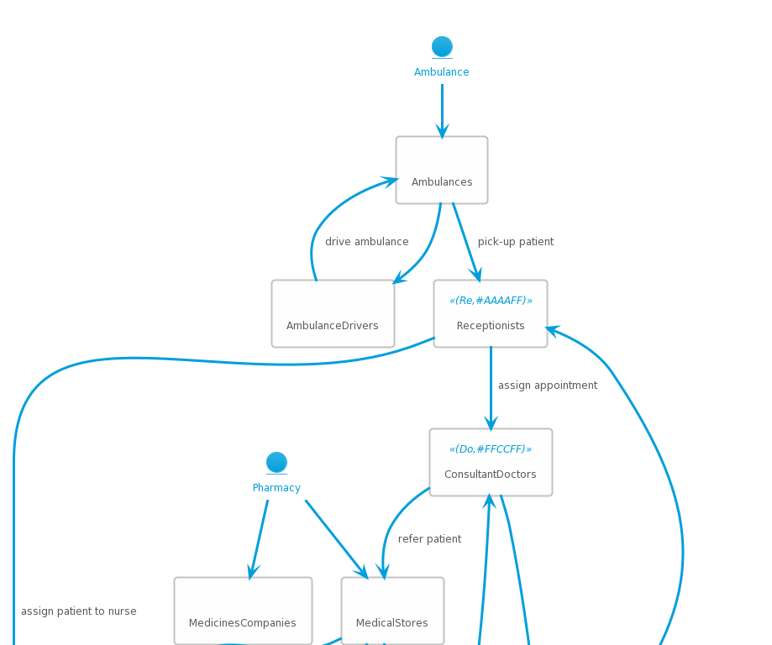
Component diagram

Slide 9
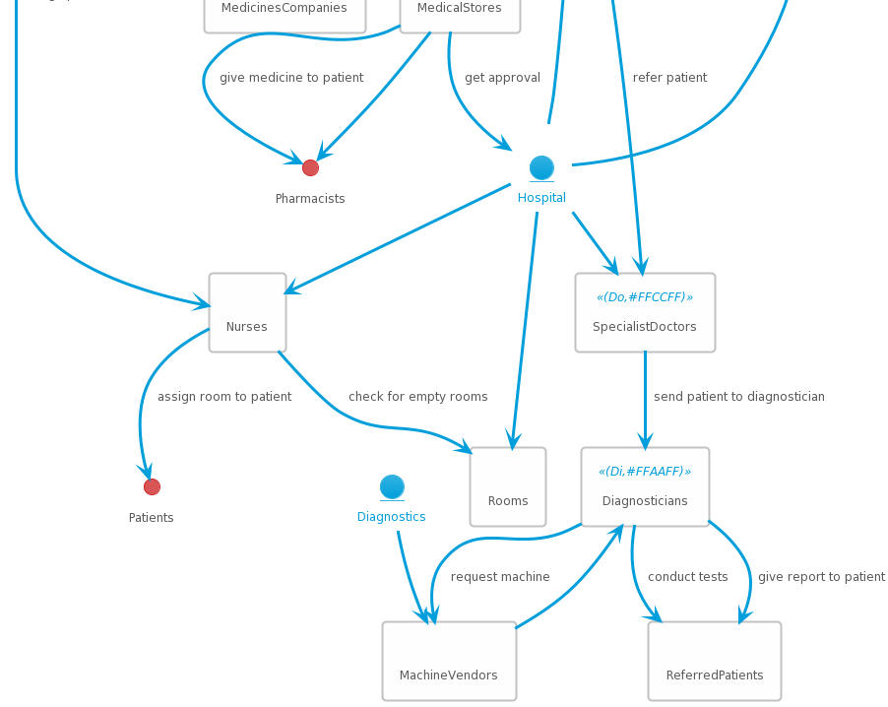
Component diagram

Slide 10
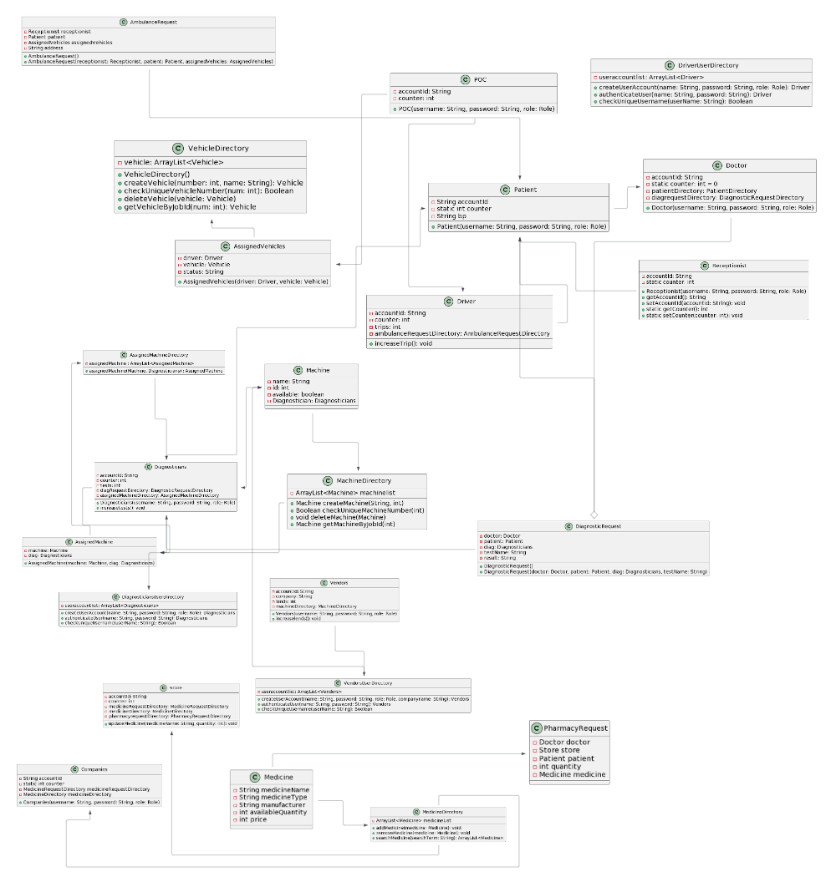
UML Class diagram

Slide 11
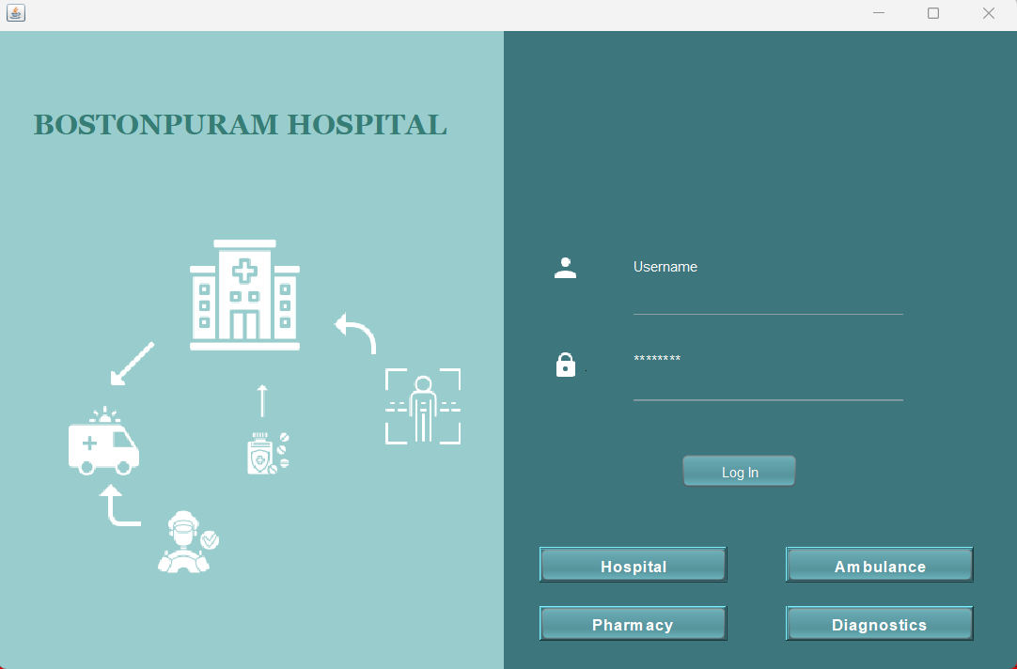
Few snapshots of the application

Slide 13
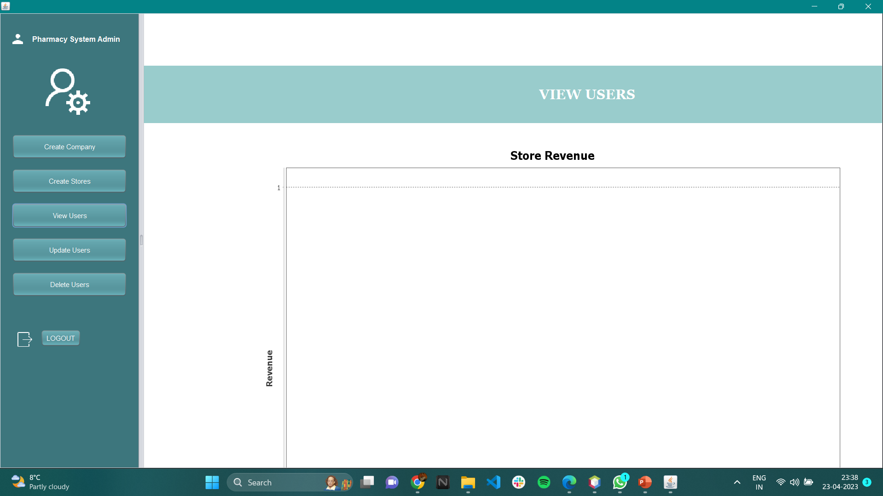

Slide 14
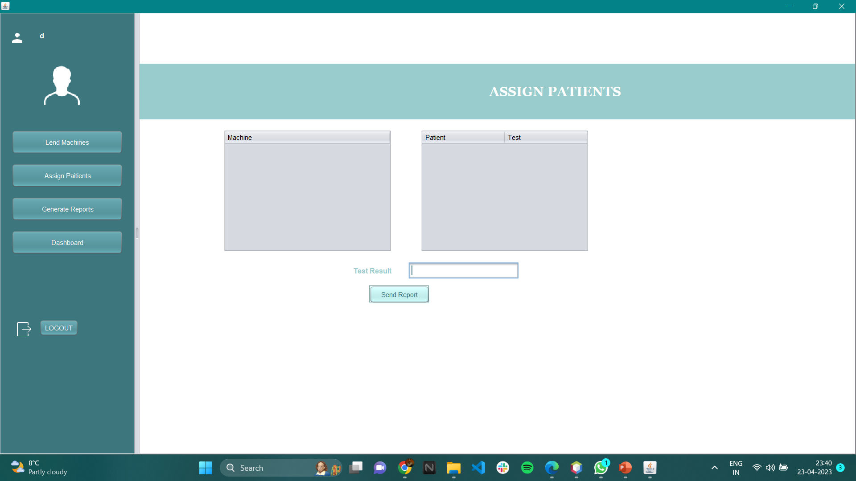

Slide 15
Players and contributions
Saketh Sai: Pharmacy enterprise, Hospital enterprise, Component Diagram
Suhasini Polampelly: Diagnostics enterprise, Hospital Enterprise, Presentation
Sashank Machiraju: Ambulance enterprise, Hospital Enterprise, UML Diagram

Slide 16
Thank you

